Slide 1


OBJECT ORIENTED PROGRAMMING THROUGH JAVA
V.DIVYA
ASSISTANT PROFESSOR
CSE DEPT.
MLR INSTITUTE OF TECHNOLOGY

Slide 2
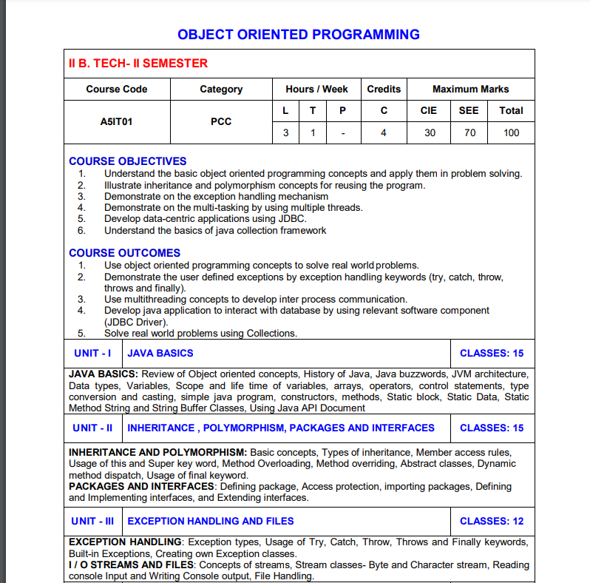

Slide 3
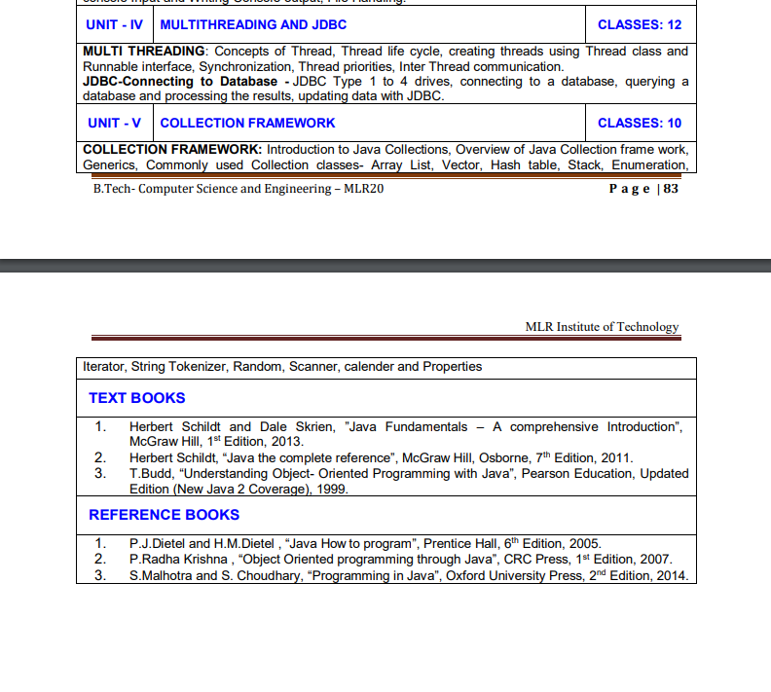

Slide 4

L0- INTRODUCTION
(NEED FOR PROGRAMMING)

Slide 5
Introduction
INTRODUCTION
The computer programs help in automating the tasks which are time consuming, error prone, repetitive, not person dependent etc.,
For e.g., an activity like send greeting card will contain small steps like
go to the greeting card shop,
choose it,
pay for it,
write the names and address,
go to the post office,
buy stamps, affix the stamps and
drop the card in the post drop box.
Time-consuming
Repetitive
Error prone

Slide 6
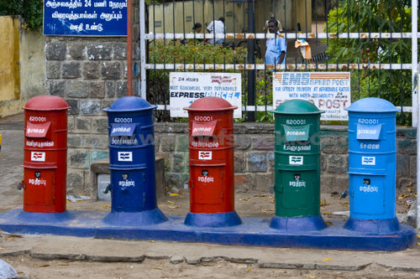

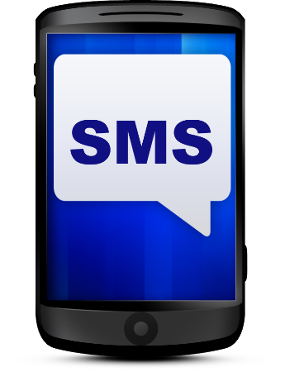
Example 1 (Communicating with others)
EXAMPLE-1(COMMUNICATING WITH OTHERS)
Observe 10 – 15 year back, how people used to communicate from different places – POST CARDS
  Email – Less than 1-minute to send an email to any place in the world at no cost.
  Mobile – Directly we can speak to the persons, we can also use SMS system.
  And many more…..

Slide 7
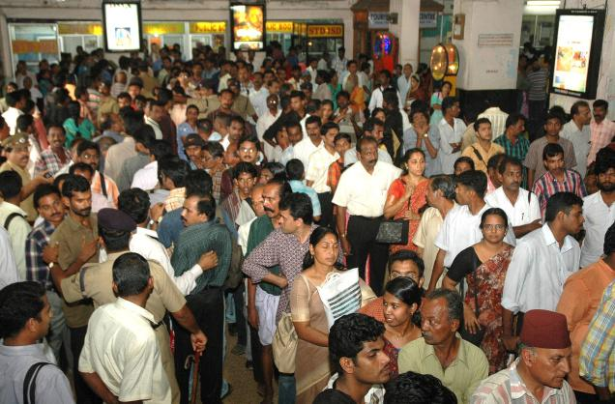




Example 2 (Booking Railway Tickets)
Observe 10 – 15 year back, how people used to get train tickets – From Rail Reservation Counter
  IRCTC– Can book tickets from anywhere to anywhere, sitting at home.
  Movie Tickets
  Bus Tickets
  Flight Tickets
  And many more…..

Slide 8
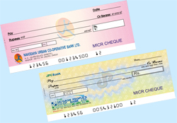
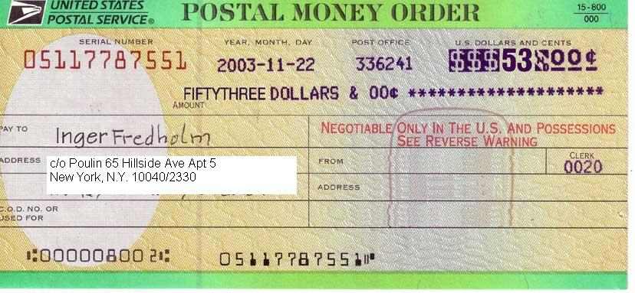

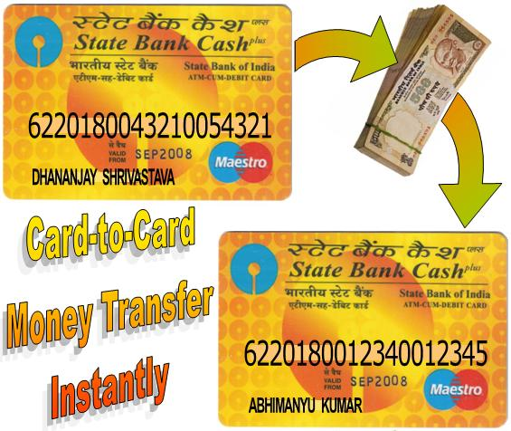
More Examples ……
More Examples
Sending money from parent to the child studying in a college
Seat allocation in engineering college
And many more…..

Slide 9
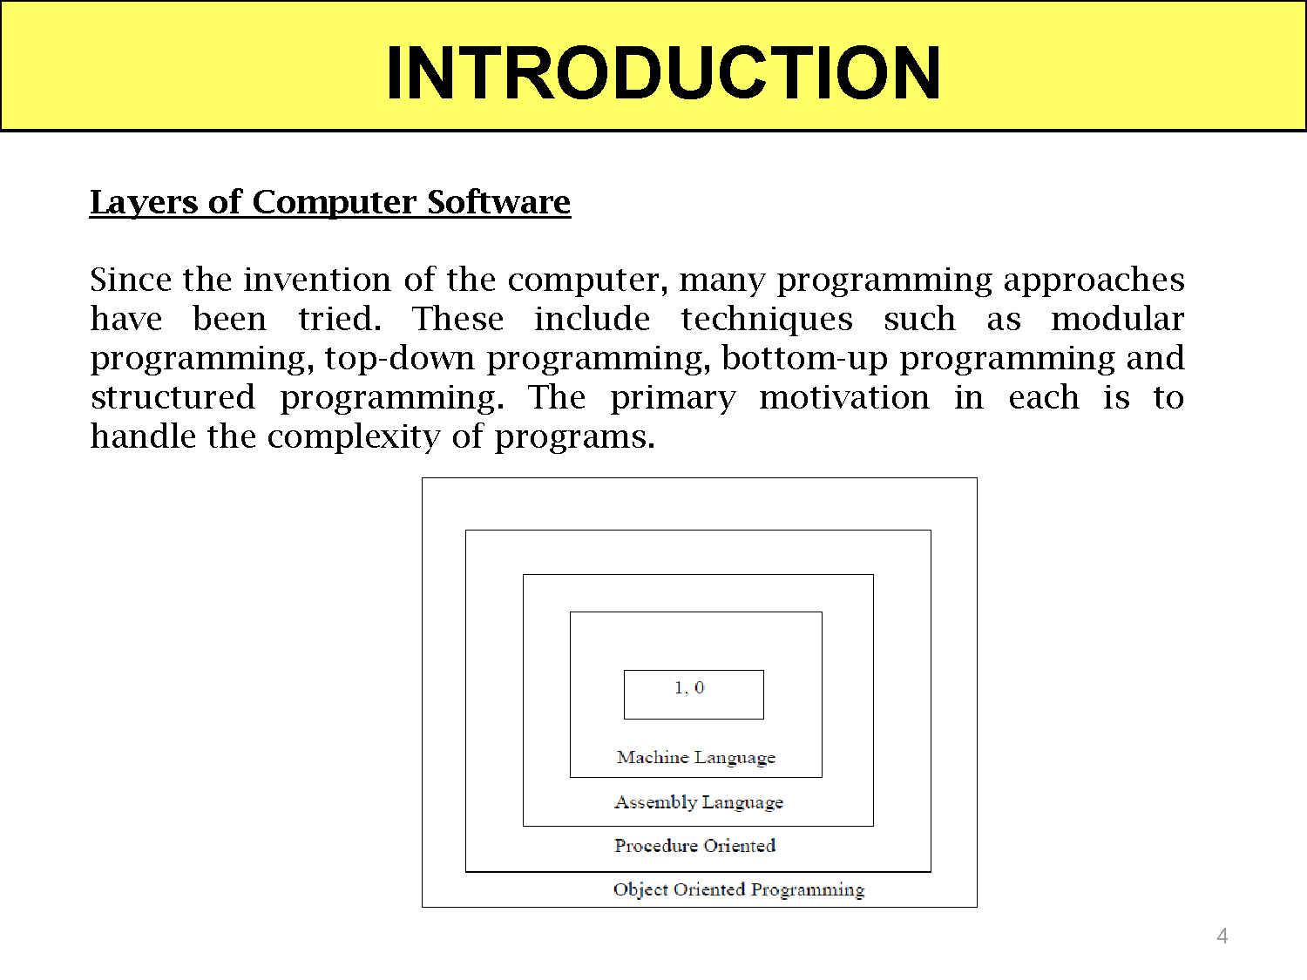

Slide 10
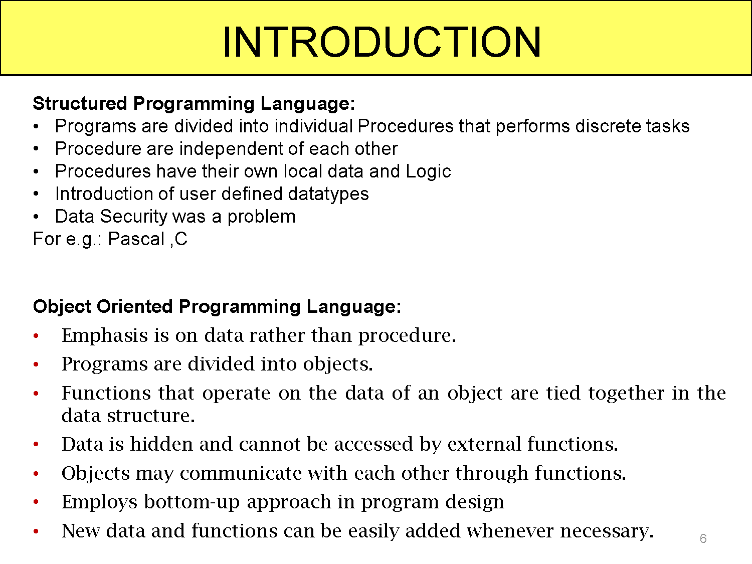

Slide 11
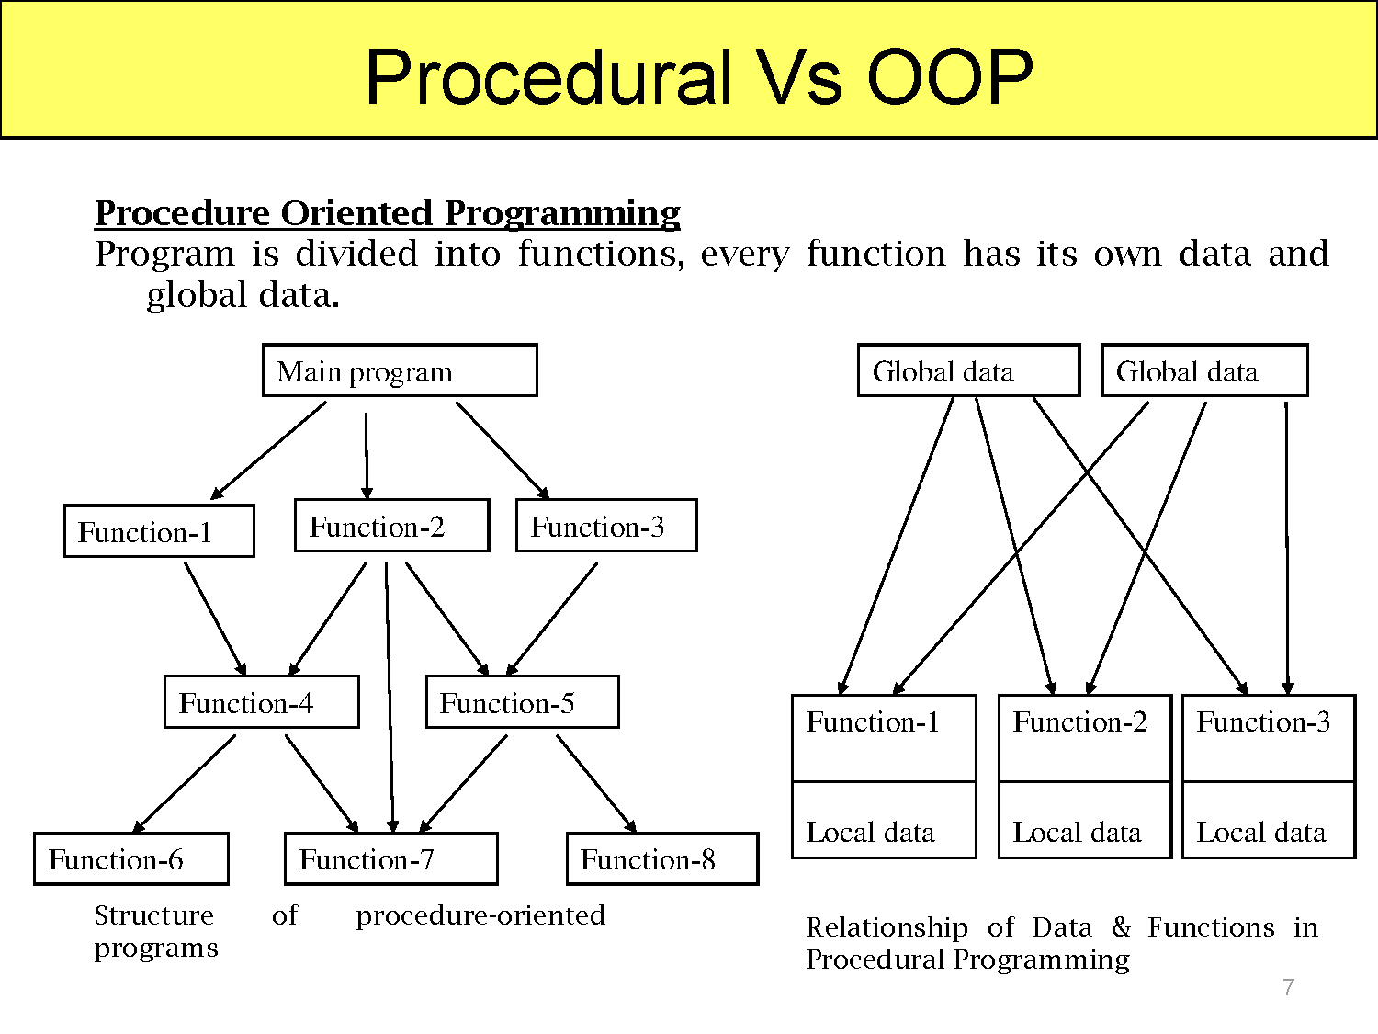

Slide 12
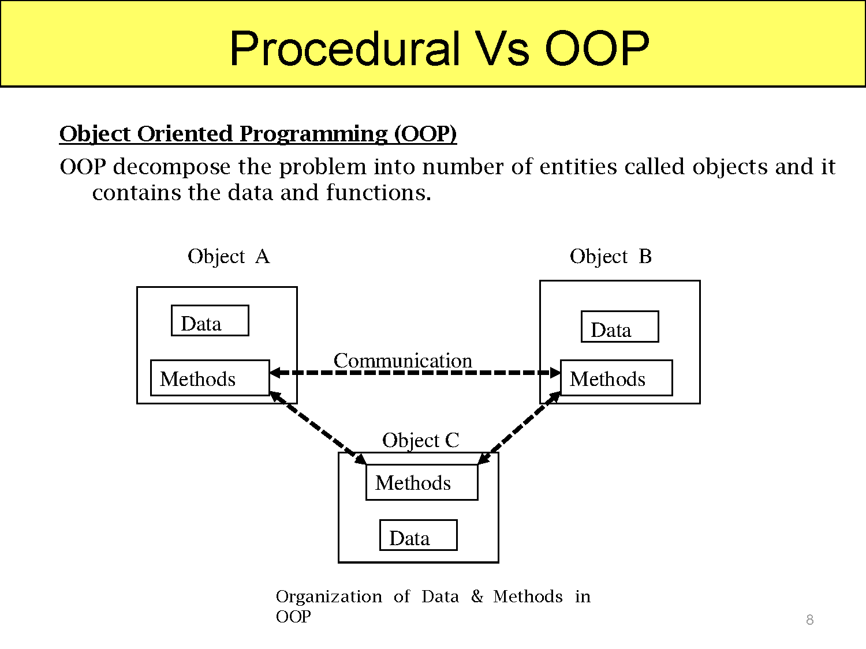

Slide 13
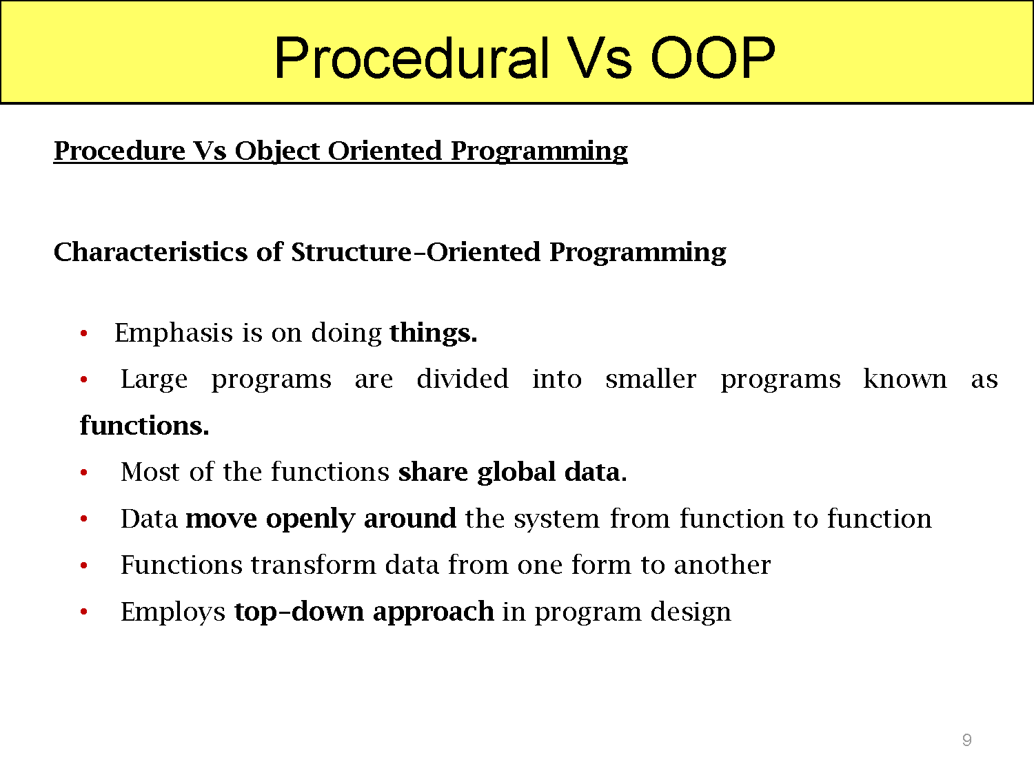

Slide 14
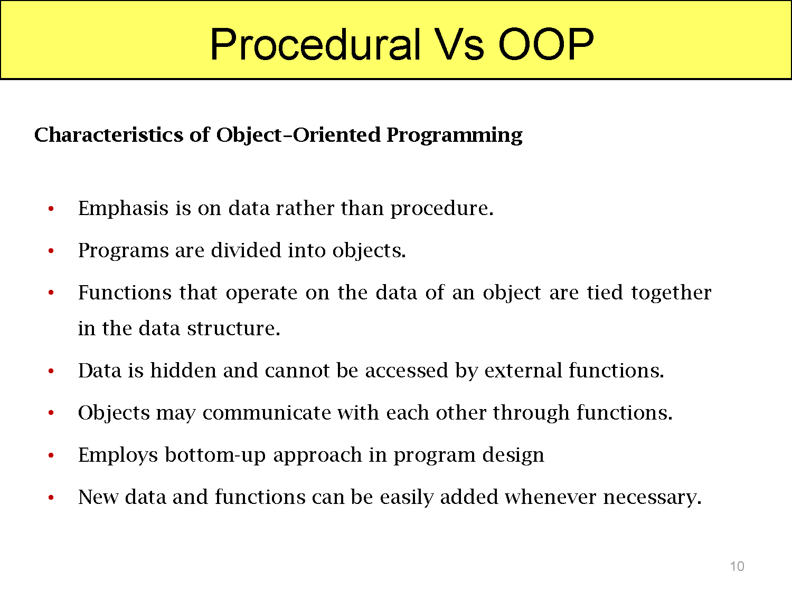

Slide 15



